Slide 1


Using Twitter to predict cryptocurrency prices
Claudeon Reinard Susanto

Slide 2

“Cryptocurrency?? Twitter??”
- you probably

Slide 3
Outline of this presentation
Problem
1
Solution
2
Discussion
3

Slide 4
Problem
1
Problem
What is cryptocurrency?
Crypto’s volatility
Limitations of past studies
2
Solution
3
Discussion

Slide 5

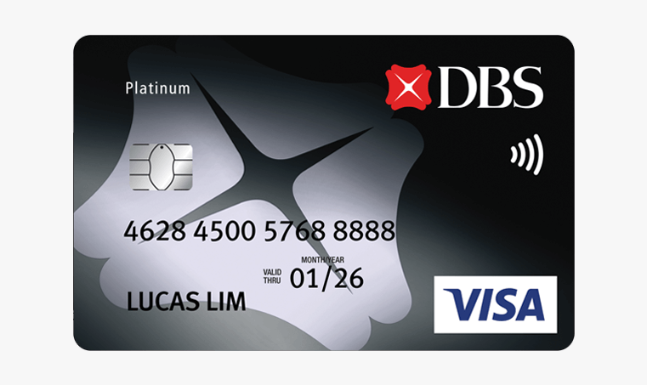
Problem
Cryptocurrency is a form of digital currency that is secured using cryptography (algorithm)
+
=
Cryptography
Digital currency
Cryptocurrency

Slide 6
Problem
Cryptocurrency is faster than digital currency as 3rd party is not needed
Bank
You
Digital currency
Destination

Slide 7
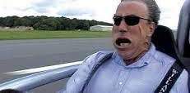
Problem
Cryptocurrency is faster than digital currency as 3rd party is not needed
You
cryptocurrency
Destination

Slide 8
Problem
Cryptocurrency is more secure than digital currency as it is less susceptible to failures
cryptocurrency
Bank
You
Digital currency
Destination

Slide 9
Problem
Statistics shows cryptocurrency will become increasingly more mainstream in the future
300 million global crypto users as of today
Global crypto market value is $10.02 billion as of 2022
Source: CoinMarketCap

Slide 10
“Hopefully I have convinced you to start buying crypto”
- trust me bro

Slide 11
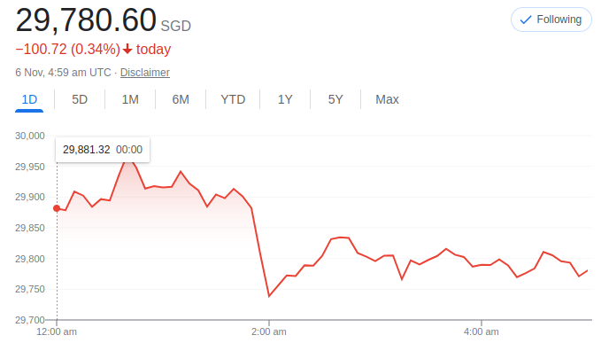
Problem
Cryptocurrency prices are highly volatile and thus unpredictable
Source: Google Finance
Dropped by $200 in a minute!!!

Slide 12
Problem
Volatile prices make it difficult for potential buyers and sellers to make decisions
Source: Google Finance
buy low sell high
Should I wait or buy now?

Slide 13

Problem
Predicting prices is necessary to generate returns and hence profits $$
Source: Google Finance
buy low sell high
Hmmm 🤔 I know prices will rise soon so I better buy now!

Slide 14
“But from where and how can we predict prices?”
- somebody once told me

Slide 15
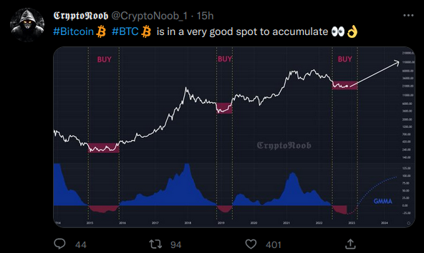
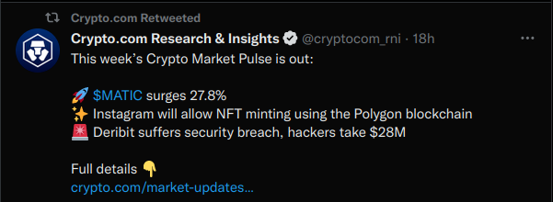
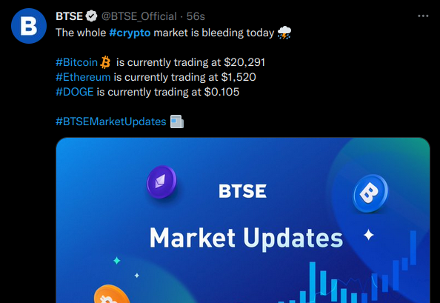
Problem
Twitter data can potentially predict cryptocurrency prices!

Slide 16
Problem
Twitter data can potentially predict cryptocurrency prices!
Instant updates
Comprehensive info on crypto market

Slide 17
Problem
There has been limited research on the relationship between Twitter and crypto
until…

Slide 18
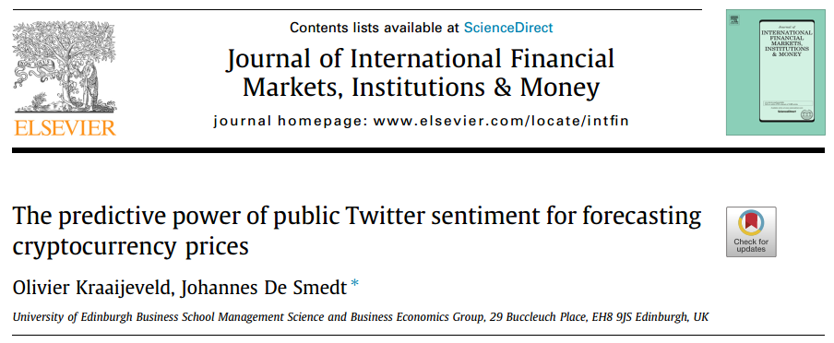
Problem
Solution

Slide 19
Problem
Solution
1
Problem
2
Solution
Twitter data and cryptocurrency
Methodology
Results and significance
3
Discussion

Slide 20
Problem
Solution
Two reasons why Twitter data is used to predict prices
1
2
Real-time updates
Insights on crypto market expectations

Slide 21
Problem
Solution
Twitter data is updated in real time, unlike the relatively slower news channels
1
Real-time updates

Slide 22



Problem
Solution
Twitter data is updated in real time, unlike the relatively slower news channels
>
Twitter posts
News articles

Slide 23

Problem
Solution
Twitter data is updated in real time, unlike the relatively slower news channels
1
2
Real-time updates
Insights on crypto market expectations

Slide 24
Problem
Solution
Twitter posts provide insights on market expectations and sentiments
2
Insights on crypto market expectations

Slide 25
Problem
Solution
Twitter posts provide insights on market expectations and sentiments

Slide 26
Problem
Solution
Twitter provides comprehensive and real-time updates on cryptocurrency!
Real-time updates
Insights on crypto market expectations

Slide 27
Problem
Solution
Is it possible to predict prices by looking at Twitter sentiments?
Real-time updates
Insights on crypto market expectations

Slide 28

Problem
Solution
In theory, we can know current market expectations and use this to predict prices
demand/ supply
Twitter posts
Crypto investors expectations
affects
Crypto prices

Slide 29
Problem
Solution
To test this claim, the researchers measured association between sentiments and prices
association?
correlation?
Twitter sentiments
Crypto prices

Slide 30
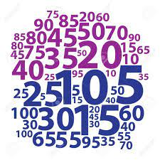

Problem
Solution
Crypto prices are numbers but Twitter sentiments are not quantifiable!
association?
correlation?
Twitter sentiments
Crypto prices

Slide 31
Problem
Solution
Sentiment analysis is used to quantify sentiments in Twitter posts

Slide 32
LIVE DEMO
Sentiment analysis

Slide 33
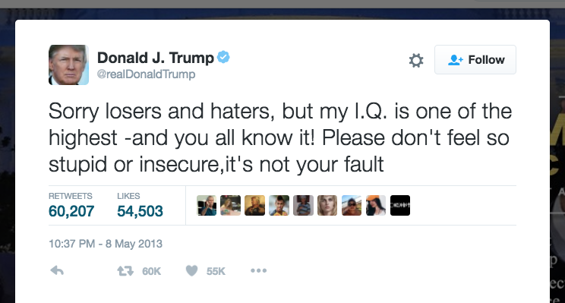
Problem
Solution
Irrelevant posts are filtered out if they do not contain keywords related to crypto

Slide 34
Problem
Solution
Irrelevant posts are filtered out if they do not contain keywords related to crypto
Relevant keyword

Slide 35
Problem
Solution
Each word in a post is scored according to is emotions (positive/neutral/negative)
positive
neutral
Overall sentiment: negative
negative

Slide 36
Problem
Solution
Sentiment analysis is done on the newest Twitter posts within one hour
Average hourly Twitter sentiments score
filter
score
Twitter posts
Relevant posts
Sentiment Analysis

Slide 37
Problem
Solution
Researchers did hourly sentiment analysis and compared the score with prices over 2 months
Sentiment Analysis
Average hourly Twitter sentiments score
compare
filter
score
Twitter posts
Relevant posts
Crypto prices

Slide 38
Problem
Solution
There is correlation/association between Twitter sentiments and crypto prices!
correlation!
Twitter sentiments
Crypto prices

Slide 39
Problem
Solution
There is correlation/association between Twitter sentiments and crypto prices!
prices
sentiments
+ve
time
1h
2h
3h
-ve

Slide 40
Problem
Solution
Twitter has the power to predict cryptocurrency prices!
prices
sentiments
+ve
time
1h
2h
3h
sentiments
-ve

Slide 41
Problem
Solution
Discussion
1
Problem
2
Solution
3
Discussion
Limitations
Applications
The Future of Cryptocurrency

Slide 42

Problem
Solution
Discussion
Researchers did not test the accuracy of the prediction
ACCURACY?

Slide 43


Problem
Solution
Discussion
14% of tweets were posted by bot accounts, but the effects on prediction were not studied
BOTS

Slide 44
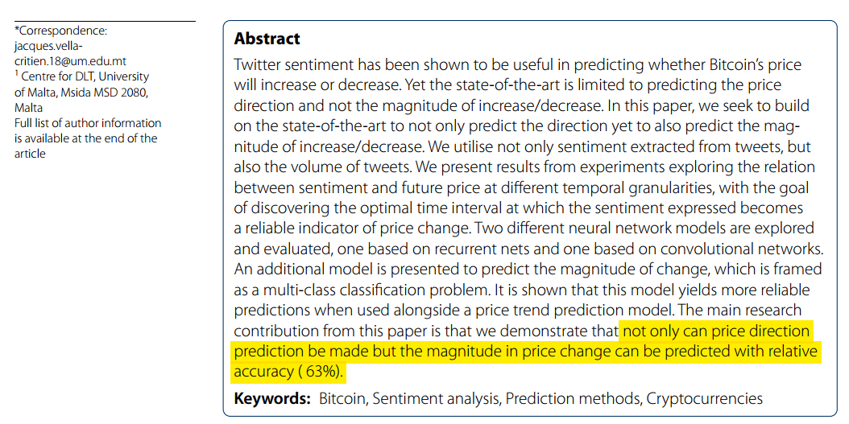
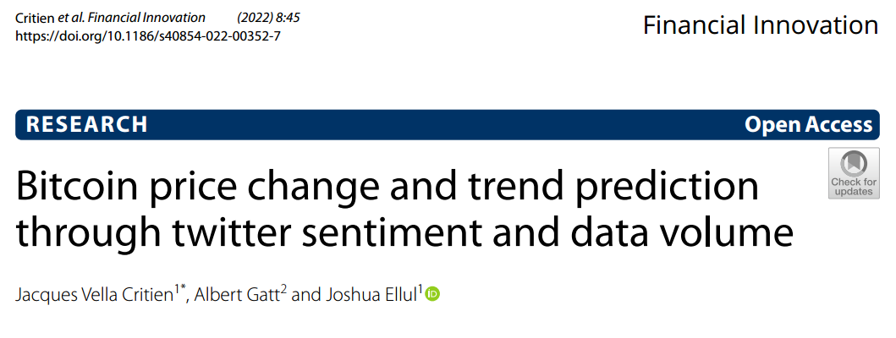
Problem
Solution
Discussion
Methods in this paper laid the foundation for other studies researching crypto and Twitter
63% Accuracy!

Slide 45
Problem
Solution
Discussion
As the adoption of crypto increases, it becomes increasingly important to keep ourselves updated of current events and trends in the cryptocurrency market using Twitter

Slide 46
Me after this 10 mins presentation:
Sentiment analysis

Slide 47
Problem
Solution
Discussion
References
Chow, R. P. Y., Ho, K. T., & Chan, P. Y. (n.d.). AI Investment Advisor in cryptocurrency. MScCompSc Project COMP7705 MSP21007. Retrieved October 31, 2022, from https://wp.cs.hku.hk/2021/msp21007/
Critien, J. V., Gatt, A., & Ellul, J. (2022). Bitcoin price change and trend prediction through Twitter sentiment and Data Volume. Financial Innovation, 8(1). https://doi.org/10.1186/s40854-022-00352-7
Frankenfield, J. (2022, September 18). Cryptocurrency explained with pros and cons for investment. Investopedia. Retrieved October 2, 2022, from https://www.investopedia.com/terms/c/cryptocurrency.asp
Kraaijeveld, O., & De Smedt, J. (2020). The predictive power of public twitter sentiment for forecasting cryptocurrency prices. Journal of International Financial Markets, Institutions and Money, 65, 101188. https://doi.org/10.1016/j.intfin.2020.101188
Yeo, H. (2021, April 30). Using Twitter to forecast cryptocurrency returns #1 - how to Scrape Twitter for sentiment analysis. Medium. Retrieved October 31, 2022, from https://medium.com/atoti/how-im-failing-my-twitter-sentiment-analysis-for-cryptocurrency-prediction-149a1730a6fd

Slide 48
Problem
Solution
Discussion
Image sources
https://toppng.com/show_download/79864/twitter-logo/large
https://www.cleanpng.com/png-bitcoin-png-20515/download-png.html
https://imgflip.com/memegenerator/248724477/Hacker-man-black-guy
https://www.bestinsingapore.co/best-debit-cards-singapore/
https://uci.nus.edu.sg/oca/2021/10/15/western-frontier-canteen/
https://www.google.com/search?channel=fs&client=ubuntu&q=bitcoin+price+chart
https://sites.google.com/site/usingdigitalresources/home/personal-needs/online-news
https://guides.canadacollege.edu/political_science/news
https://www.independent.co.uk/news/world/americas/9-11-front-pages-newspapers-september-11-b2164421.html
https://www.amazon.ca/Hide-Pain-Harold-Blank-Notebook/dp/B0851MGZQV
https://whitman.com.my/article/much-ado-cryptocurrency/
https://www.123rf.com/photo_29001884_text-cloud-numbers-wordcloud-typography-concept-vector-illustration.html

Slide 49
Q&A

